Slide 1
RARS Software Application
Team Koala/ COMP90009
Team Koala

Slide 2
Presentation Objective
“
After reading through project background and conducted some research study, we established requirements elicitations to better understand the project's motivation and its requirements. 11 user stories are found, and a final solution is conducted based on it and presented as a digital prototype
Team Koala/ COMP90009
”

Slide 3


Team Member
Team Koala/ COMP90009
Lei Chen
Sufan Xia
Kaixuan Guo
Yi Gao

Slide 4
Presentation Structure
Team Koala/ COMP90009
Background Introduction
Projects and Requirements
Solution
01
02
03

Slide 5
01
Team Koala/ COMP90009
Background
Introduction
This section will brief present: our Client, background of the project, project motivation.

Slide 6



Background Introduction
Team Koala/ COMP90009
Client:
Brian Mcdermott
Radio Frequency Interference (RFI)
Project Motivation: RFI, Radio Communication

Slide 7
02
Team Koala/ COMP90009
Projects and Requirements
This section will brief present: our projects, requirements for our projects, as well as the requirement analysis processes.

Slide 8
Requirement Analysis Pr cess
Inception
Initialised client meeting and had a basic understanding of the project
Elicitation
Engaged stakeholders to understand their goals -> goal model
Elaboration
Refined requirements, developed personas and paper prototypes
Negotiation
Reconciled conflicts through negotiation
Specification
Finished specifications: documents, goal models, user stories, paper prototypes and digital prototypes
validation
Validated the quality of all software requirements

Slide 9
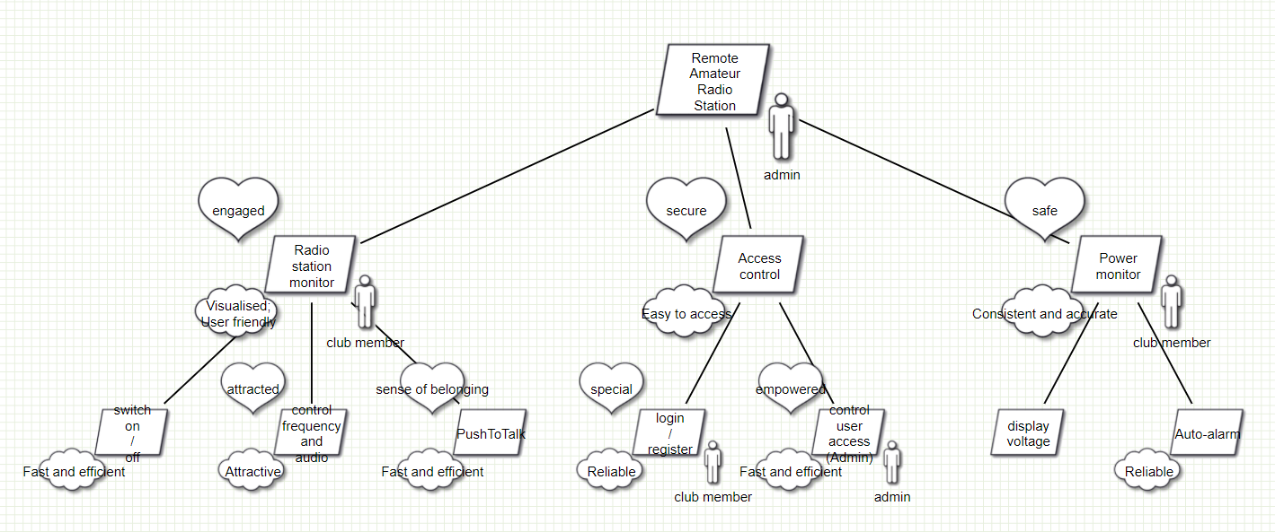
G al Model
Team Koala/ COMP90009

Slide 10
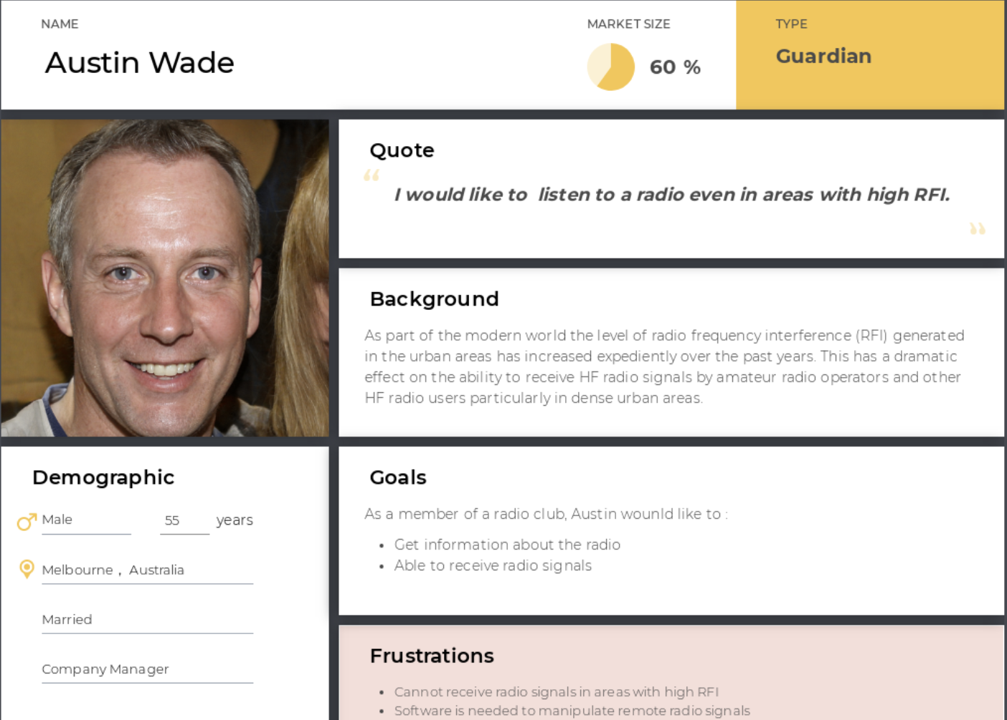
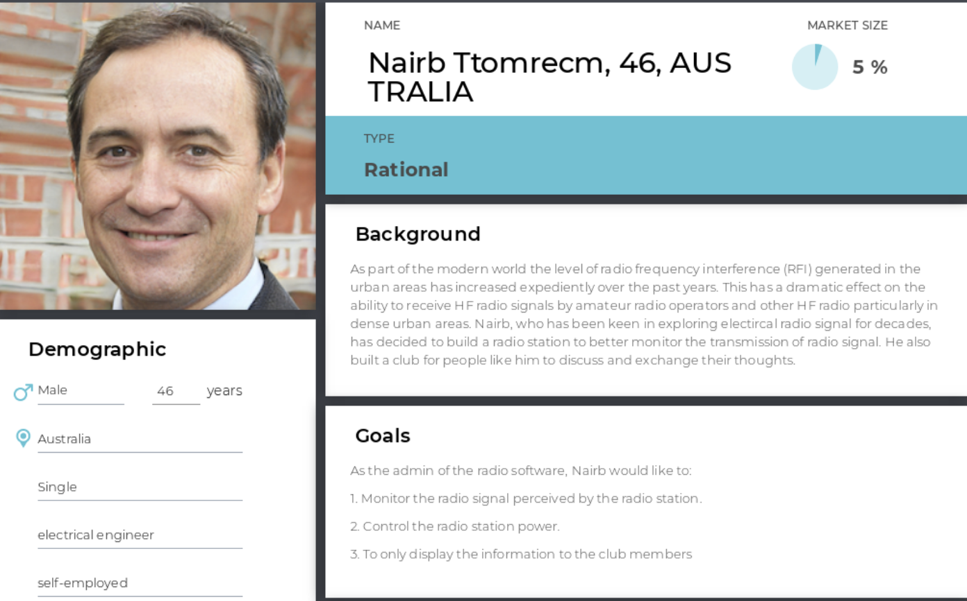
Pers nas
Team Koala/ COMP90009

Slide 11
User st ries
Team Koala/ COMP90009
Epic ID | Epic | User Story ID | As a <role> | I want to <do something> | So that <achieve some goals> | Priority | Size Estimation
1 | Login/register | 1 | Admin | Create an account for my club member | They can use the accounts to login | M | Small
 |  | 2 | Admin | Manage access of user account | I can detect/create the users accounts | M | Medium
 |  | 3 | Admin/Club member | Login | I can start to use the system | M | Small
 |  | 4 | Admin | Edit my profile | I can update my information | C | Small
2 | Manage the radio station | 5 | Admin | Switch on/off radio station | I can close it at home | M | Small
3 | Manage Auto-alarm system | 6 | Admin | Be alarmed when power is lower than threshold | I can perform safety actions | S | Medium
 |  | 7 | Admin | Set an alarm threshold | I can be alarmed when power is lower than threshold | S | Small
4 | Display voltage | 8 | Admin | See the voltage of the system | I can monitor the power level | M | Small
5 | Display radio interface | 9 | Admin/Club member | Switch between different channels | I can listen to the channel I like | S | Medium
6 | Push-to-Talk | 10 | Admin/Club member | Adjust the volume of the radio | I can listen to it at a suitable volume | S | Small
 |  | 11 | Admin/Club member | Push a button and start to talk to others | I can communicate with other club members on a certain channel | S | Large

Slide 12
Acceptance test
Team Koala/ COMP90009
Acceptance Criteria ID | Acceptance Criteria | Step | Acceptance Test | Critical |  | Test Result
 |  |  |  | Yes | No | Accept | Reject
1.1 | Given I have logged in and on user page, When I find the user I want to delete and click the 'delete' button at the end of the user information, Then I can delete the user accounts to maintain security of the website. | 1 | Admin is at the home page. |  | ✔️ | ✔️
 |  | 2 | Admin clicks the "User profile" button on the top bar. | ✔️ |  | ✔️
 |  | 3 | The page is redirected to the user profile page. | ✔️ |  | ✔️
 |  | 4 | Admin clicks the "Delete user" button in the middle. | ✔️ |  | ✔️
 |  | 5 | The page is redirected to the user control page. | ✔️ |  | ✔️
 |  | 6 | Click the delete icon to the right of the user you want to delete, then the user will be deleted from the database. | ✔️ |  | ✔️
1.2 | Given I have logged in and on user page, When I want to add an user, I click the add button and input that user id of the user I want to add, Then I can add the user accounts to maintain security of the website. | 1 | Admin is at the home page. |  | ✔️ |  | ✔️
 |  | 2 | Admin clicks the "User profile" button on the top bar. | ✔️ |  | ✔️
 |  | 3 | The page is redirected to the user profile page. | ✔️ |  | ✔️
 |  | 4 | Admin clicks the "Add user" button in the middle. | ✔️ |  | ✔️
 |  | 5 | A pop up window emerges with auto-generated id and password. | ✔️ |  | ✔️

Slide 13
03
Team Koala/ COMP90009
Solution
This section will brief present: our solution as digital prototype.

Slide 14
S lution
Team Koala/ COMP90009
Digital Prototypes

Slide 15
Thank you!
Team Koala/ COMP90009
Presented by Team Koala

